Slide 1
Lymphatic Drainage

Slide 2
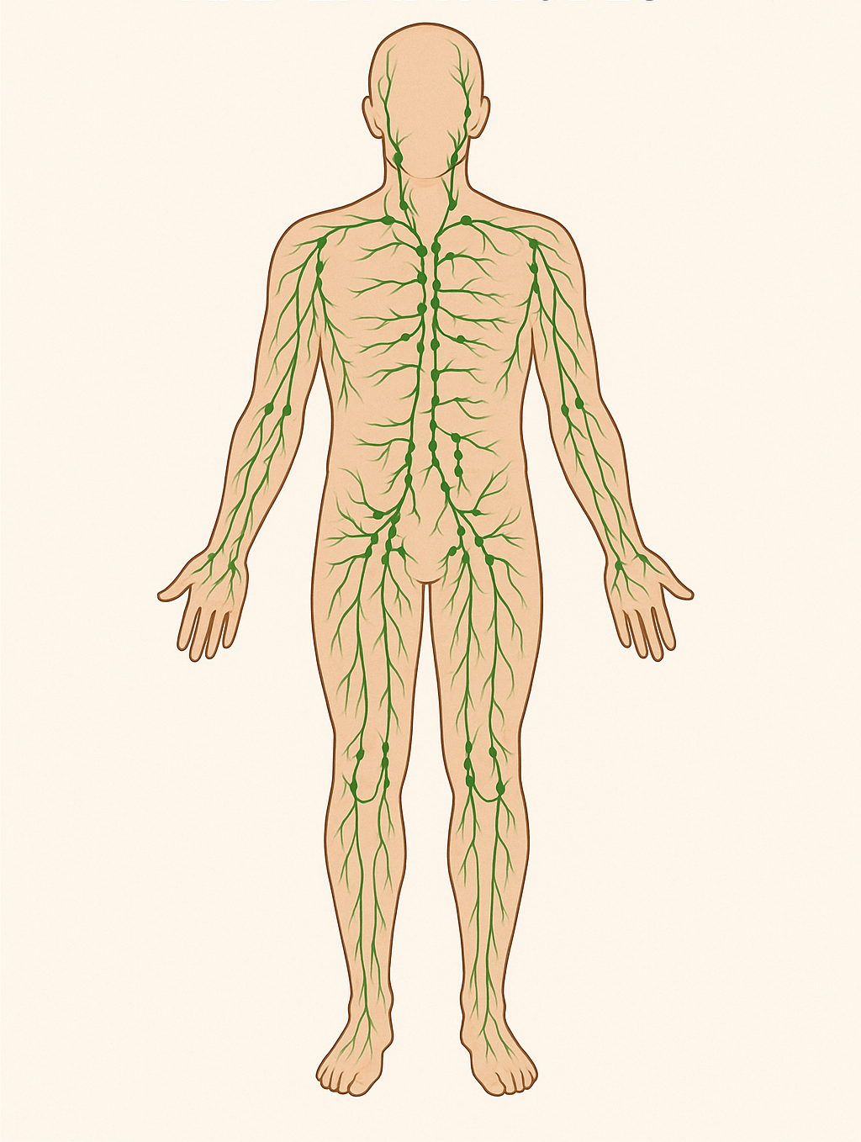
What is the Lymphatic System?
Network of vessels and lymph nodes
Supports immune function
Removes waste, toxins and excess fluid

Slide 3
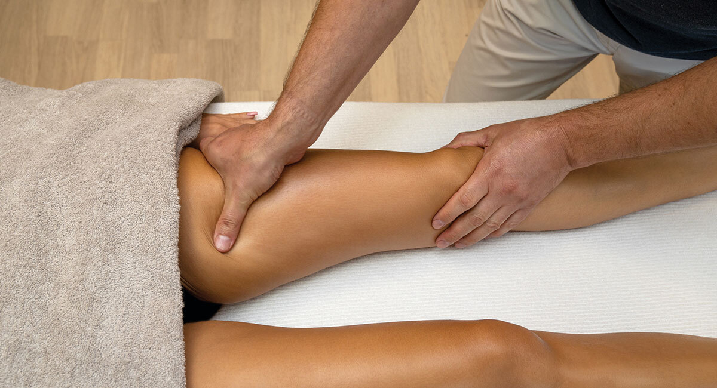
What is Lymphatic Drainage?
Gentle massage technique
Stimulates flow of lymph
Helps reduce swelling, detoxify, and support immune health

Slide 4
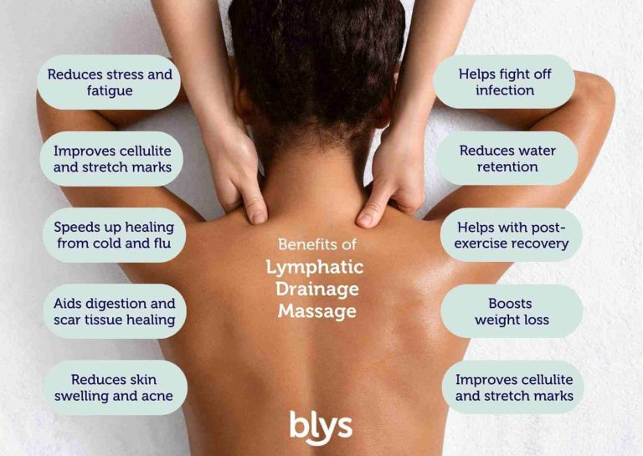

Slide 5
Lymphatic System: Structure and Function
Second circulatory system: Runs parallel to the blood circulatory system
Components:
Lymph
Lymphatic vessels
Lymph nodes
Organs
Primary functions:
Fluid balance
Immune defense
Waste removal
Fat absorption

Slide 6
Lymphatic System: Structure and Function
The lymphatic system is sometimes called the “garbage disposal” of the body.
It plays a role in preventing infections, managing inflammation, and ensuring tissue fluid levels stay balanced.
Unlike blood, lymph does not have a central pump like the heart. It relies on muscle contraction, breathing, and manual techniques to move.
Lymph nodes act like security checkpoints, trapping pathogens and presenting them to immune cells for destruction.

Slide 7
Structure
The lymphatic system is a network of tissues, vessels, and organs that works alongside the cardiovascular system to:
1
2
3
4
Drain interstitial fluid (fluid between cells)
Filter and destroy pathogens
Support immune function
Absorb and transport fats

Slide 8
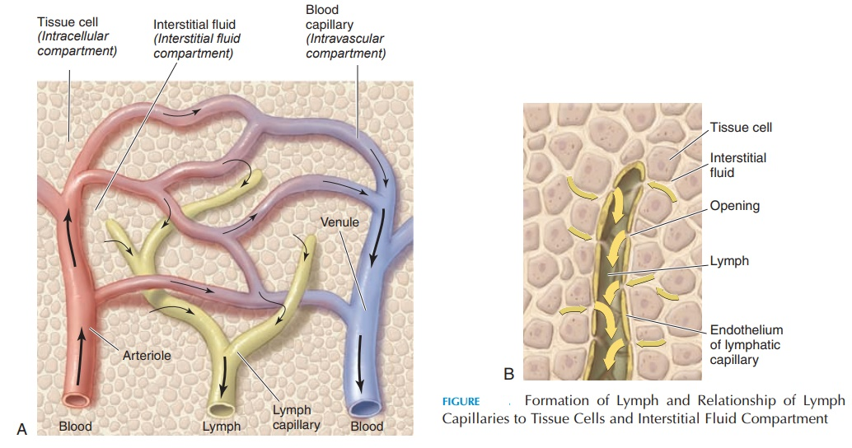
1. Lymph Fluid (Lymph)
Clear, colorless fluid originating from blood plasma that leaks into tissues.
Contains white blood cells, especially lymphocytes (T cells and B cells), proteins, fats, toxins, and cellular debris.

Slide 9
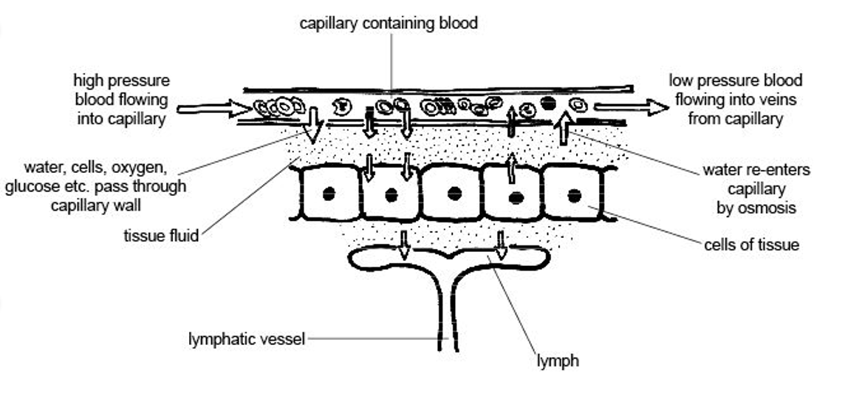
2. Lymphatic Vessels
Thin-walled vessels that run throughout the body, parallel to blood vessels.
Begin as capillaries in tissue spaces → merge into larger vessels → drain into the thoracic duct or right lymphatic duct, which empty into the subclavian veins near the collarbones.
These vessels have one-way valves that prevent backflow, similar to veins.

Slide 10
3. Lymph Nodes
Small, bean-shaped structures located along lymphatic vessels.
Act as filtration hubs: they trap bacteria, viruses, and debris.
Contain immune cells (T cells, B cells, macrophages) that destroy invaders.
Swell during infection or inflammation due to increased immune activity.

Slide 11
4. Lymphoid Organs
Spleen: Filters blood, recycles red blood cells, and stores immune cells. Located in the upper left abdomen.
Thymus: Site of T cell maturation. Located behind the sternum.
Tonsils & Adenoids: First line of immune defense in the throat/nasal area.
Bone Marrow: Produces lymphocytes and other blood cells.
Peyer’s Patches: Small lymphatic tissue in the small intestine (gut immunity).

Slide 12
Major Lymph Nodes and Regions
Head & Neck
Upper Body
Thoracic & Abdominal
Lower Body

Slide 13
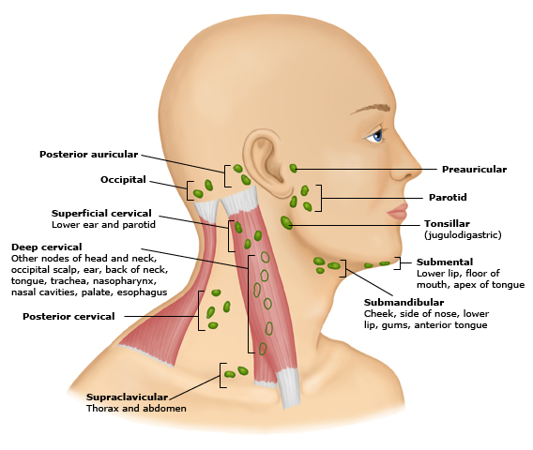
Head and Neck
Cervical Nodes: Along the sides of the neck.
Submental: Beneath the chin
Submandibular: Under the jaw
Preauricular/Postauricular: In front of and behind the ears
Deep cervical: Along the internal jugular vein
Function: Drain the scalp, face, mouth, throat, and ears.

Slide 14
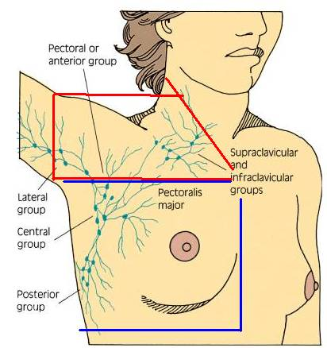
Upper Body
Axillary Nodes: In the armpits
Drain the arms, upper chest, and breast tissue (especially important in breast cancer)
Supraclavicular Nodes: Just above the collarbone
Drain the upper chest and abdomen
Note: Enlargement here can indicate serious underlying conditions.

Slide 15
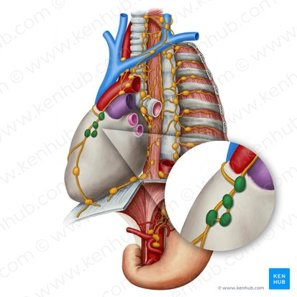
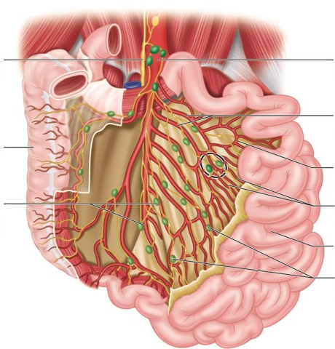
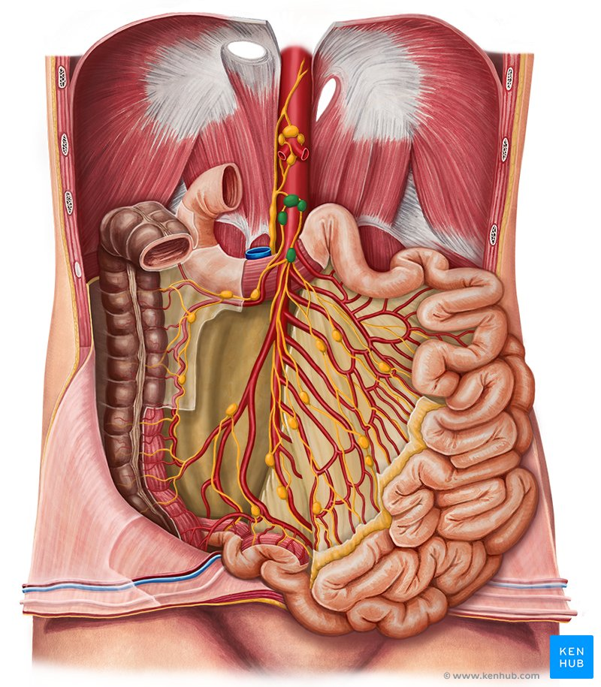
Thoracic & Abdominal
Mediastinal Nodes: Located between the lungs
Mesenteric Nodes: In the intestinal mesentery
Retroperitoneal Nodes: Behind abdominal organs
These nodes filter lymph from the lungs, GI tract, liver, and other internal organs.

Slide 16
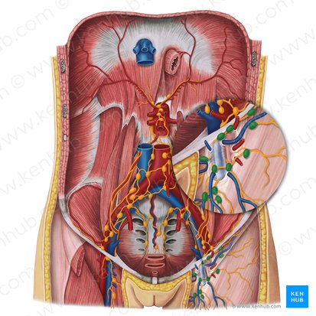
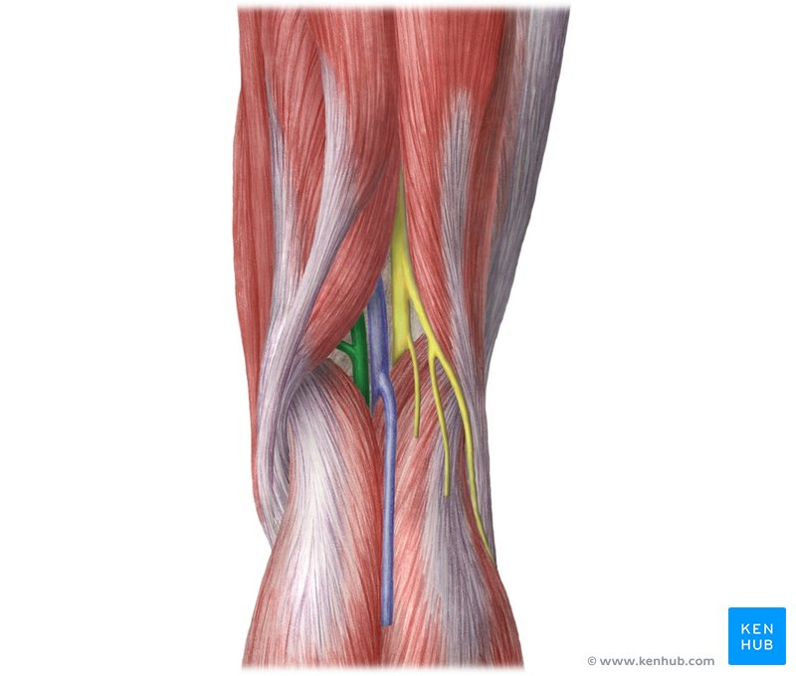
Lower Body
Inguinal Nodes: In the groin
Drain the lower abdomen, buttocks, external genitalia, and legs
Popliteal Nodes: Behind the knees
Drain the lower legs and feet

Slide 17
MLD Instructions
Gentle, rhythmic movements to encourage lymph flow toward the major lymph nodes.
⚠️ Always clear proximal areas (near the heart) before working distally (farther from the heart). This "creates space" for lymph to flow. ⚠️ Use feather-light pressure (skin-stretch only)—too much pressure collapses lymphatic capillaries.

Slide 18
Key Tips for Practicing MLD
Pressure: Use only enough pressure to move the skin, not the muscle
Speed: Very slow (1 stroke per second or slower)
Breath: Encourage deep, diaphragmatic breathing to support drainage
Hydration: Drink water before and after to support toxin removal
Posture: Keep the body relaxed and supported during the session

Slide 19
General Flow Sequence
Terminous (Supraclavicular area)
Neck & Face (if applicable)
Axillary region
Abdomen
Extremities (arms → hands, legs → feet)
Inguinal region
Back region

Slide 20
1. Stimulate the Terminus (Always begin here)
Location: Just above the collarbones, beside the sternum
Technique:
Use gentle circular or pumping motions with fingers
Repeat 5–10 times
Stimulates drainage into the subclavian veins

Slide 21
2. Neck (If working on head or face)
Clear the cervical nodes on the sides of the neck
Use slow, circular strokes moving toward the collarbone
Always stroke in the direction of lymph flow (downward on sides)

Slide 22
3. Axillary Nodes (Armpits)
Gently stretch skin into the armpit using flat hands
Use rhythmic, circular movements
Repeat 5–10 times per side

Slide 23
4. Abdominal Drainage
Focus on the cisterna chyli (above navel)
Use slow clockwise circular motions around the belly button
Combine with deep belly breathing:
Inhale deeply (belly expands)
Exhale slowly (gently compress with hands)

Slide 24
5. Arm Drainage (Right or Left)
Start high near the shoulder, working downward in sections:
Upper arm → axilla
Forearm → elbow
Hand → wrist
Technique: Light strokes moving lymph proximally (toward the armpit)
Support arm and work with the tissue, not against it

Slide 25
6. Leg Drainage (Right or Left)
Start high on the thigh, working downward in sections:
Thigh → inguinal nodes
Knee → popliteal fossa
Calf → ankle
Foot → ankle
Repeat strokes 5–10 times per area
Always move lymph toward groin (inguinal nodes)

Slide 26
7. Inguinal Nodes (Groin Area)
Use gentle pumping motions inward and upward
Located in the creases between the thighs and pelvis

Slide 27
8. Back
Stimulate flow toward the axillary (armpit) and inguinal (groin) nodes
Clear the posterior (spinal) watershed
Support drainage from the back, shoulders, and lower spine

Slide 28
5 Primary Watersheds
Sagittal (Midline)
Clavicular (Horizontal Upper Body)
Transverse (Abdominal)
Spinal (Posterior)
Gluteal

Slide 29
Lymphatic Watersheds
Lymphatic watersheds are anatomical dividing lines that separate lymph drainage territories.
Each region drains toward its nearest group of lymph nodes and does not typically cross into another territory unless rerouted manually (e.g., after surgery or trauma).
Watersheds guide the direction of manual strokes and help avoid congestion.

Slide 30
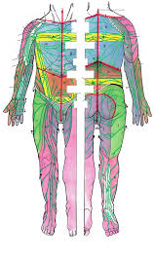
Sagittal (Midline) Watershed
Location: Runs vertically down the center of the body (forehead → chin → sternum → pubic bone)
Divides: Right and left sides of the body
Drainage Direction:
Right side → right lymph nodes (e.g., right axillary, inguinal)
Left side → left lymph nodes (e.g., left axillary, inguinal)

Slide 31
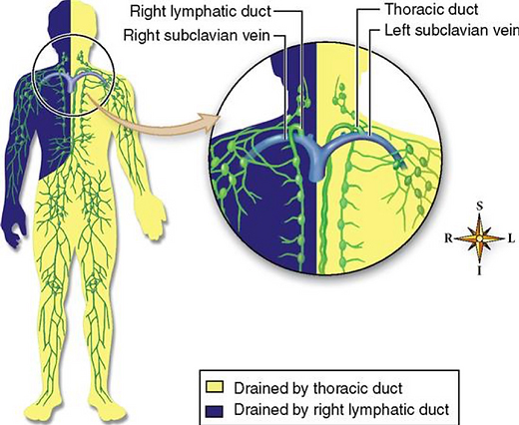
Clavicular (Horizontal Upper Body) Watershed
Location: Runs horizontally below the clavicles
Divides: Head/neck from the torso
Drainage Direction:
Above → drains into cervical nodes
Below → drains into axillary nodes

Slide 32
Transverse (Abdominal) Watershed
Location: Runs horizontally across the waist (umbilicus level)
Divides: Upper torso from lower torso
Drainage Direction:
Above → drains to axillary nodes
Below → drains to inguinal nodes

Slide 33
Spinal (Posterior Midline) Watershed
Location: Runs along the spine from skull to sacrum
Divides: Left and right posterior body
Drainage Direction:
Similar to sagittal watershed, but for the back
Left → left axillary/inguinal nodes
Right → right axillary/inguinal nodes

Slide 34
Gluteal Watershed
Location: Runs horizontally across the gluteal fold (top of buttocks)
Divides: Lower back/buttocks from upper thigh
Drainage Direction:
Upper buttocks → drain to lumbar or sacral nodes
Lower buttocks → drain to inguinal nodes

Slide 35
Application in MLD
When performing lymphatic drainage:
Always work proximal to distal: start by clearing the terminus (collarbone area), then open lymph nodes in the area.
Follow watershed boundaries unless you're intentionally using anastomoses (bypass routes).
If nodes are removed or damaged, you can reroute lymph across watersheds using trained techniques.
Anastomoses (Bypass Pathways)
Naturally occurring overlap between lymph territories
Examples:
Axillo-axillary anastomosis: Across the chest
Axillo-inguinal anastomosis: Between armpit and groin
Inguino-inguinal anastomosis: Across the lower pelvis

Slide 36
What Happens After MLD?
All manual lymphatic drainage techniques aim to move lymph back into the bloodstream. This final step happens via two major ducts:
Thoracic Duct
The Right Lymphatic Duct

Slide 37
The Thoracic Duct (Main Drainage Highway)
Drains lymph from:
The entire left side of the body (head, neck, chest, arm, abdomen, leg)
The right lower body (abdomen, leg)
Pathway:
Starts in the cisterna chyli, a lymph collection sac in the abdomen (near L2 vertebra)
Travels upward through the chest
Empties into the left subclavian vein, just beneath the left collarbone
Function:
Carries ~75% of all lymph fluid back into blood circulation
Includes fat-rich lymph (chyle) from the digestive system

Slide 38
The Right Lymphatic Duct
Drains lymph from:
The right upper quadrant of the body:
Right side of head and neck
Right arm
Right chest
Pathway:
Empties into the right subclavian vein, just under the right collarbone
Function:
Handles the remaining ~25% of the body's lymph load

Slide 39
Final Return to Circulation
Once lymph enters the subclavian veins, it mixes with venous blood and re-enters systemic circulation
From there, waste is processed by the liver and kidneys for elimination
This return pathway is why MLD begins proximally (near the clavicles) — to open the “drains”

Slide 40
Why This Matters in MLD
The thoracic duct must be cleared first for lymph to have somewhere to go
Deep abdominal breathing stimulates the cisterna chyli and enhances drainage
A blockage near the clavicles can cause fluid to back up through the whole system

Slide 41
Contraindications
Acute Infections
Active Cancer
Do not perform MLD without physician clearance in cases of:
DVT (Deep Vein Thrombosis)
Congestive Heart Failure
Kidney Failure

Slide 42
What Is Edema?
Edema is an abnormal accumulation of fluid in the interstitial space (between cells). It can occur from inflammation, poor circulation, lymphatic blockage, trauma, or surgery.
1. Pitting Edema
Test: Press a fingertip into the swollen area (typically on the shin, ankle, or forearm) and hold for 5 seconds.
Positive Sign: If a visible indentation (“pit”) remains for several seconds after release.
Indicates: Fluid-rich swelling; often linked to:
Venous insufficiency
Congestive heart failure
Kidney or liver disease
Approach with caution: MLD may be helpful but only after medical clearance.

Slide 43
2. Non-Pitting Edema
Test: Same fingertip press does not leave a lasting indentation
Texture: Often feels firm, rubbery, or fibrotic
Indicates: More chronic or lymph-based cause (lymphostatic or lymphedema)
Lymph node damage
Surgical removal (e.g., mastectomy)
MLD is highly indicated for this type
Tip:
Always observe the symmetry, skin texture, temperature, and pain response
Teach the Stemmer’s Sign: Try pinching a skin fold on the top of the second toe or finger. If you can’t lift the skin, it may indicate lymphedema

Slide 44
How to Work Around Scars or Surgery Sites
1. Work Proximally First
Always start by clearing the lymphatic space above the surgical site (e.g., axilla before working on mastectomy site)
This creates “room” for drainage
2. Use Gentle Techniques Over Scar Tissue
Techniques:
Flat hand skin-stretch
Light spirals or scooping motions
Skin rolling (if fully healed) to reduce fibrosis
Never stretch or pull on fresh scar tissue

Slide 45
3. Reroute Across Watersheds If Needed
If drainage paths are blocked (e.g., axillary nodes removed), train fluid across to opposite axilla or down to inguinal nodes
Use anastomosis techniques (body’s natural crossover routes
4. Support Scar Mobility and Fascia
Once healed, MLD can help reduce:
Scar adhesions
Fascial restrictions
Fibrotic hardening
May be combined with myofascial release or cupping (with training)
Avoid:
Aggressive massage on or near fresh scars
Triggering pain, heat, or redness
Dislodging surgical drains or sutures

